Slide 1

ME 777 Final Project Rocket ANALYSIS SEDS
Reilly Webb
Kevin Bucher

Slide 2
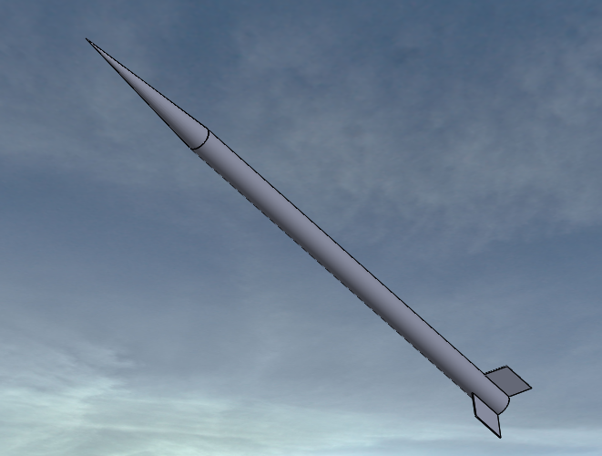
Background
SEDS UNH is building a suborbital high powered rocket for maximum altitude
Must design rocket to withstand forces acting on it
Two areas of concern are aerodynamic drag and dynamic buckling
Analysis will include the use of Solidworks and hand calculations to verify results

Slide 3
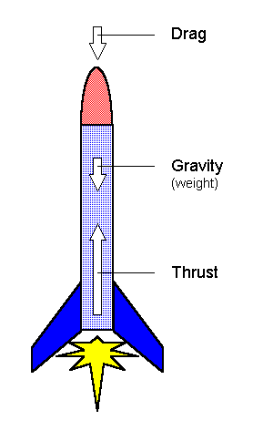
SYSTEM
Drag, Gravity and Thrust are the forces of concern
Two types of drag force: Pressure drag and friction drag
Pressure drag is caused by the pressure gradient over the length of the body
Friction drag is caused by the friction of a viscous fluid against a surface
Gravity is negligible

Slide 4
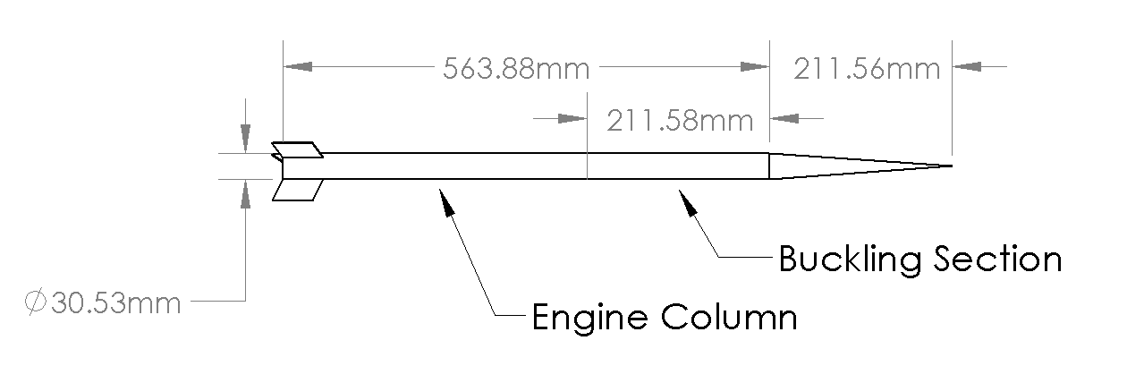
Overall Geometry
Thrust is applied at the top of engine column
This is where buckling would occur

Slide 5
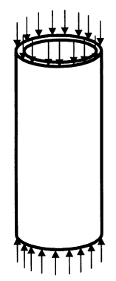

Buckling hand calculations
Assuming buckling will occur due to instantaneous thrust
Need to find critical load
Area: $A=$ $\frac{π{D_{o}}^{2}}{4}−\frac{π{D_{i}}^{2}}{4}$
Second Moment of area: $I=$ $\frac{π{D_{o}}^{4}}{64}−\frac{π{D_{i}}^{4}}{64}$
Area radius of gyration: $r=\sqrt{\frac{I}{A}}$
Critical Load: $F_{cr}=\frac{π^{2}E}{({\frac{L}{r})}^{2}}=354350.6N$
Factor of safety: $FOS=\frac{F_{cr}}{F_{thrust}}=824.071$
Critical load will likely never be reached

Slide 6
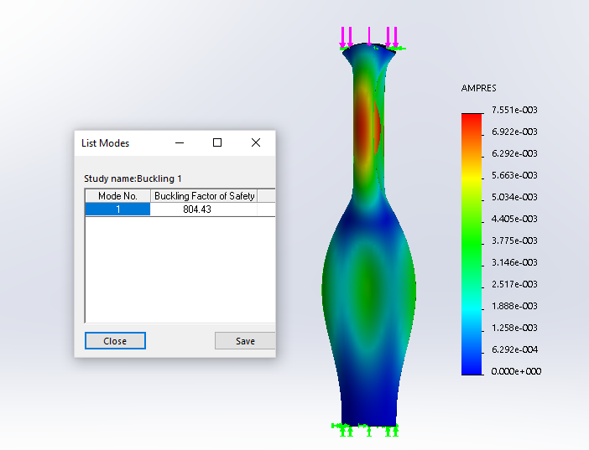
Buckling Solidworks Simulation Constraints and Loads
The section of the fuselage that houses the electrical systems and the recovery device was analyzed for buckling
The system can be simulated as a fixed-free tube during the instant the engine ignites
Max thrust load of 430 N from an I224-15A engine is applied at the free end
Factor of Safety = 804.43

Slide 7
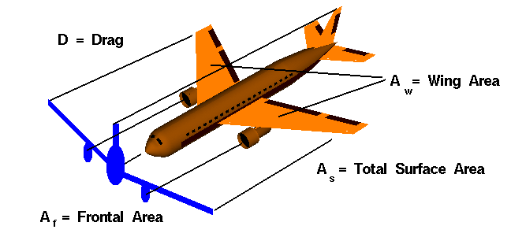
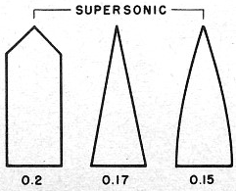

DRAG HAND CALCULATIONS
Pressure Drag
Projected Area: $A=\frac{π{D_{o}}^{2}}{4}+3bh$
Drag Coefficient: $C_{d}=.17$
Max velocity: $V_{m}=583\frac{m}{s}$ (Projected Area)
Density of air: $ρ=1.225 \frac{kg}{m^{3}}$
Pressure drag Force: $F_{PD}=\frac{1}{2}ρ{V_{m}}^{2}C_{d}A=20.7N$
(Nose Cone Coefficient of Drag)

Slide 8

DRAG HAND CALCULATIONS
Friction Drag
Effective Area: $A=2πrh+2πr^{2}+πr(r+\sqrt{h^{2}+r^{2}})$
Reynolds Number: $Re=\frac{ρV_{m}L}{μ}=22,249,115.97$
Friction Coefficient: $C_{f}=\frac{.427}{(\log\left(Re\right)−{.407)}^{2.64}}=.00256$
Max velocity: $V_{m}=583\frac{m}{s}$
Density of air: $ρ=1.225 \frac{kg}{m^{3}}$
Force of friction Drag: $F_{FD}=\frac{1}{2}ρ{V_{m}}^{2}C_{f}A=29.62N$

Slide 9
Fluid Flow Solidworks Simulation Constraints and loads
External flow simulation around a CAD model of our Conical Mk1 rocket design
Excluded internal space and cavities without flow conditions
STP conditions were assumed: 101.3 KPa, 1.225 kg/m^3, .1% turbulence intensity
A steady state analysis was performed at an estimated max free stream wind velocity of 583 m/s to determine the maximum drag forces

Slide 10
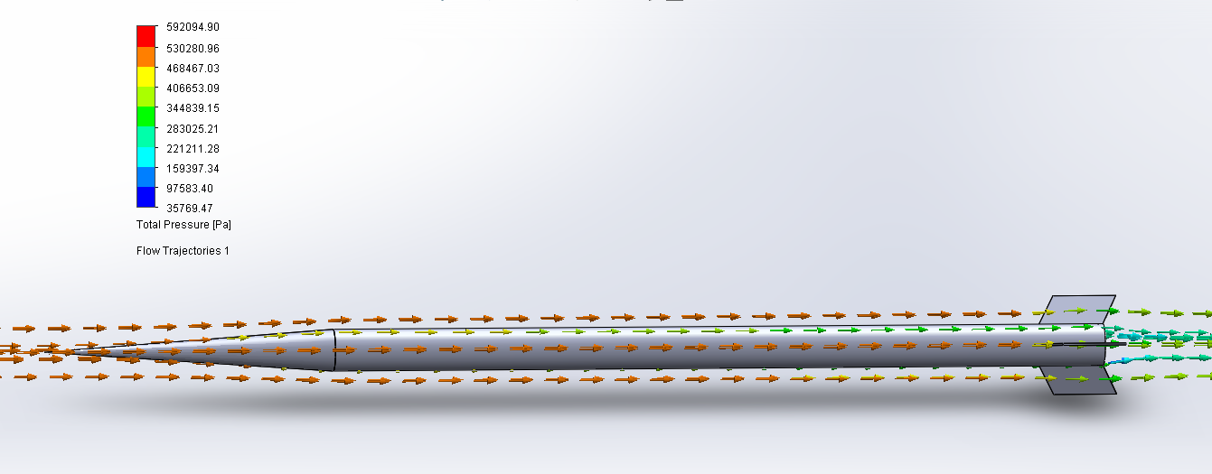
PRESSURE DRAG FORCE = 14.09 N

Slide 11
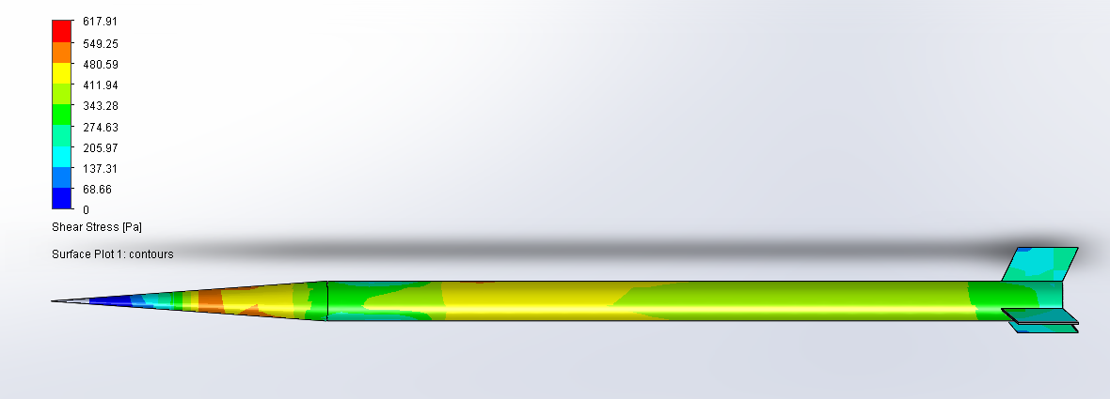
Friction Drag force = 26.84 N
Total Drag = Pressure Drag + Friction Drag = 40.93 N

Slide 12
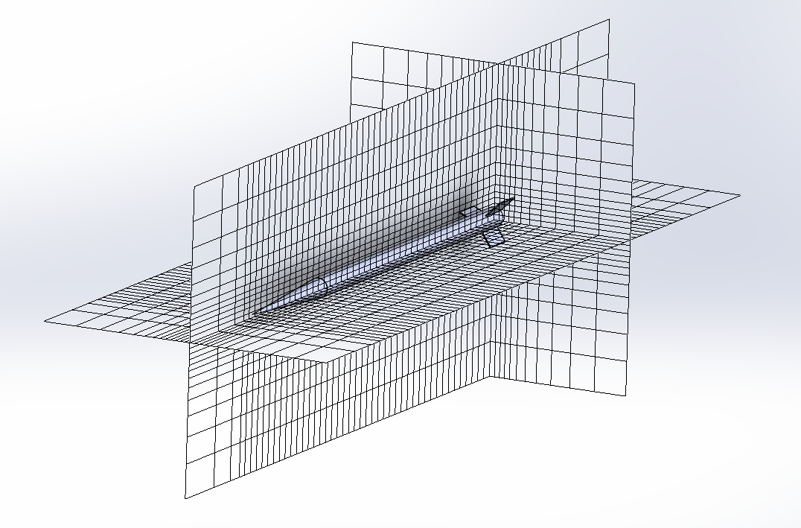
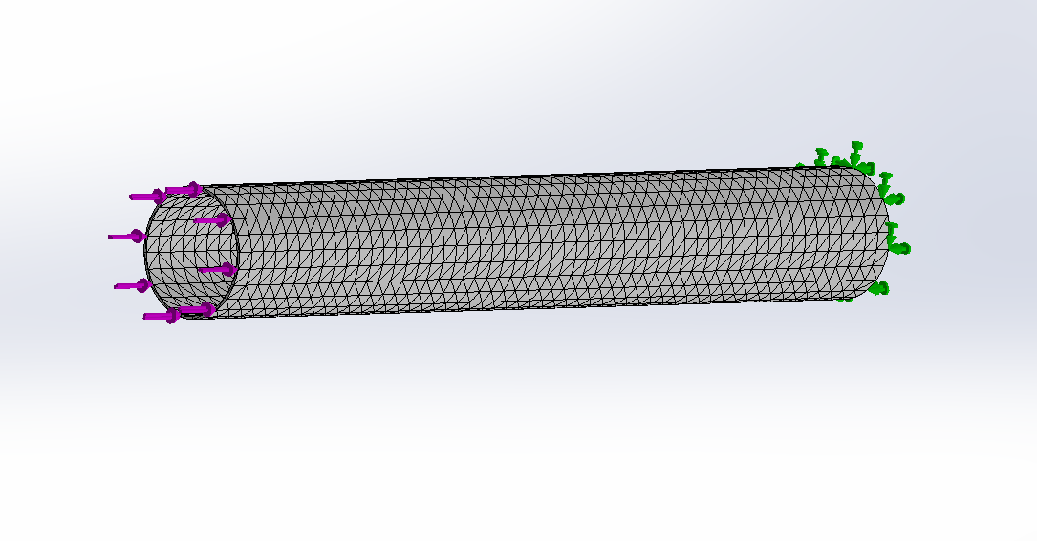
Mesh Convergence
External Fluid Flow Global Mesh
Buckling Solid Mesh
Level of initial Mesh | Total Drag Force [N]
1 | 52.67
2 | 41.51
3 (selected) | 40.93
Element Size [mm] | Factor of Safety
7.974 | 1706.2
6.080 | 1275.1
4.585 | 858.0
3.987 (selected) | 804.03

Slide 13
Simulations vs hand calculations
Analysis | Hand Calculation | Simulation Results | % Difference
Buckling Factor of Safety | 824.07 | 804.43 | 2.7%
Pressure Drag | 20.7 N | 14.09 N | 32%
Friction Drag | 29.62 N | 26.84 N | 10%
Total Drag | 50.32 N | 40.93 N | 23%
Surface Roughness was neglected in the friction drag hand calculations
Fin Area wasn’t accounted for in the friction drag hand calculations
Drag Coefficient is typically calculated experimentally, our hand calculations for pressure drag approximate it from the nose cone geometry

Slide 14
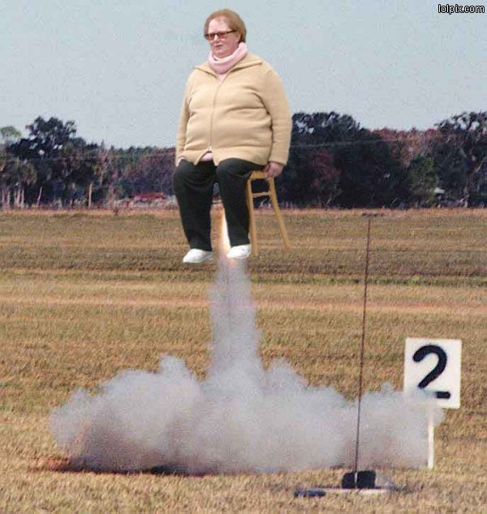
Questions

